Slide 1
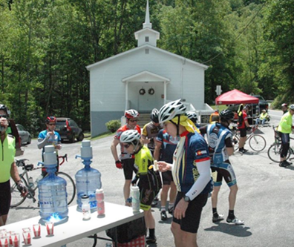
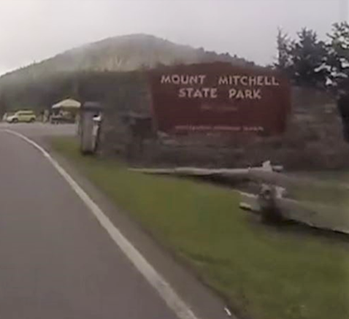
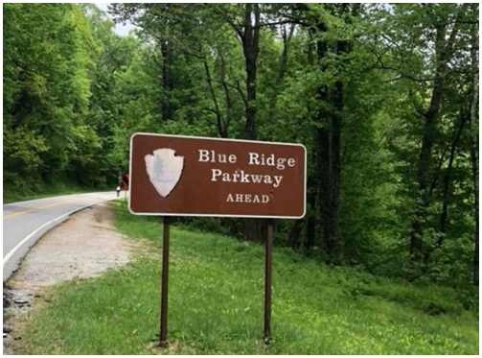

Slide 2
FREEWHEELERS OF SPARTANBURG Karl Johnson, President

Slide 3
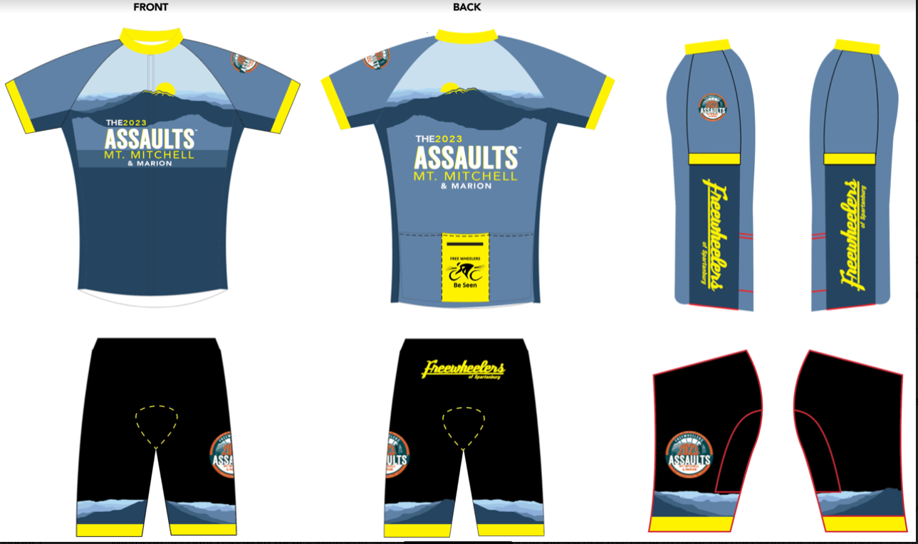
The New KIT

Slide 4
Ride Leaders
Training Rides
Richard White and Tony McAbee
Juli Rivers and Michelle Braun
Michael Forrester
How to get information on training rides:
Join Freewheelers Cycling Club of Spartanburg https://freewheelers.info/ https://theassaults.com/ and join their YAHOO GROUPS email distribution.
Join our Assaults Training page on FACEBOOK: https://www.facebook.com/groups/1417179668435362/?ref=bookmarks
Join the SCOOP ADVENTURES page on FACEBOOK
We will do our best to communicate on multiple forums to get the communication out there. Most of it will be on the FREEWHEELERS YAHOO GROUP and FACEBOOK.

Slide 5
Safety Requirements for all rides:
1.
Minimum Riders: 2 or more…may be required, see postings.
2. ID – In Case of Emergency contact – required on your person/bike (not on your mobile phone). Many different options just have one.
3. Helmets required (glasses recommended)
4. Rear Daytime Blinker Lights: REQUIRED – BE SEEN. A “Daytime” Blinker hurts your eyes if you look directly at it from arms length. Make sure that your light is charged. Lights need to point directly back (not to the ground or to the sky). Set brightness down on the night rides.
5. Headlights: Highly recommend. Be seen by oncoming cars and drivers turning. And needed on our night rides.
6. No Earbuds – to hear cars and fellow riders.
7. Obey Safe Cycling Practice https://freewheelers.info/ride-ride-safe/
8. Do Not engage / respond / react to angry motorists. Document – video / pictures / write to tell authorities if needed.
9. Be Open to Safety Feedback – we need to watch out for each other. The Ride Leader cannot see everything and can need feedback too. 10. Ride Leader Mobile:

Slide 6
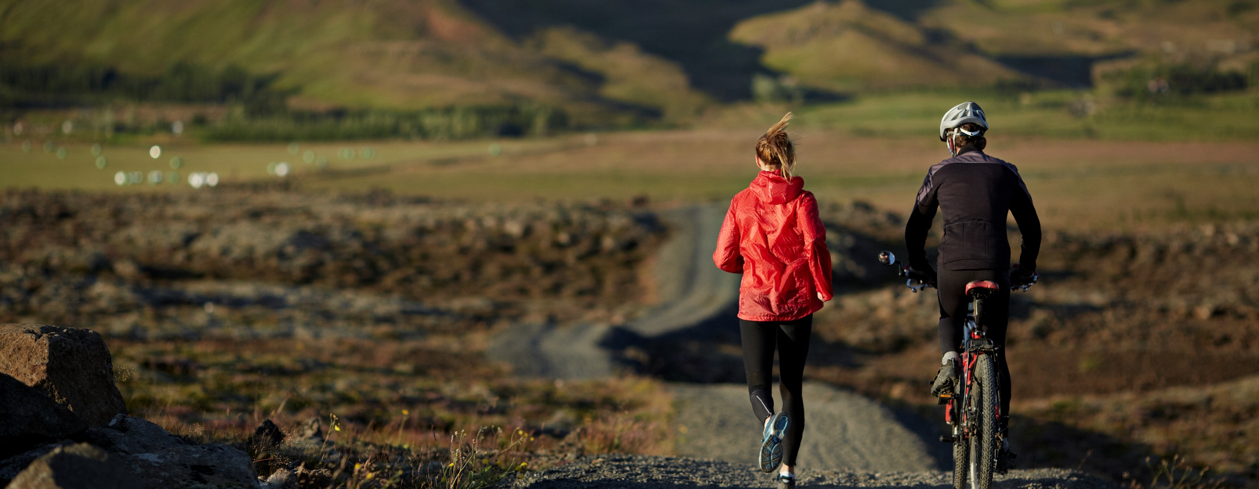
Plan for a Healthy Lifestyle
z

Slide 7
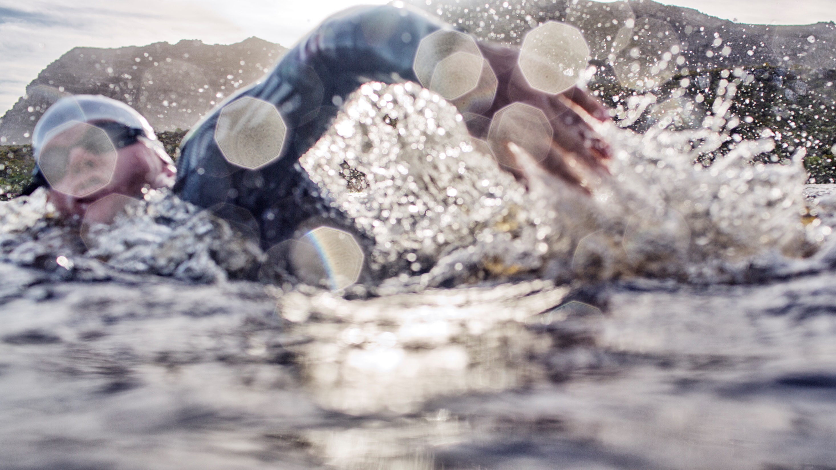
Health
Diet
Exercise

Slide 8
Fitness Progress
Healthy Lifestyle
Diet
Exercise
Hydration
Immune System
Goals
Mental Attitudes
z

Slide 9
Sites and Information to help you
Strength training to aid in Climbing:
https://youtu.be/8ic0URFZrzw
6 Essential Cycling Workouts to get Faster and Stronger:
https://blog.mapmyrun.com/6-essential-cycling-workouts-to-get-faster-and-stronger/
Strength training for cyclists:
https://youtu.be/HqmwjwTcOY8
7 Stretches for cyclists
https://gccoaching.fit/2016/12/04/7-stretches-you-should-do-after-riding-the-trainer/

Slide 10
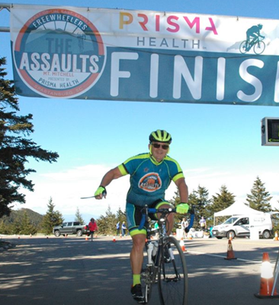
Nutrition / Fueling: Larry Hart Learning to fuel while riding
z

Slide 11
RIDE TIPS
Ride in Small Chain-Ring Front- Increase your cadence…“SPIN, You WIN”
Breathe- Breathe in through your nose, out through your mouth slowly- Practice this at work, walking, riding in your car. On bike-Three quick deep breaths if your completely out of breath.
Handle-Bar Hand Position- On hoods, on side of bar, on top of bar, CHANGE this position often
Relax your upper body, No death grips on the handlebar, Keep elbows bent
Adjust Positions on your bike- Move forward, Move back, Sit up straight, Point your toes down, Point your heels down
Stretching- Off Bike, On Bike
Stand and pedal for 50 Strokes- Stretch your back, Stretch your neck, Stretch/Role your shoulders
SAG Stops- Stop for minimum amount of time- No more than 5 minutes This is not a social meeting. Muscles cool down Lactic Acid builds up- Let the volunteers fill your bottles

Slide 12
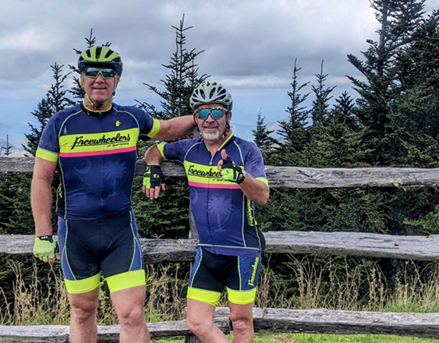
The Route “You will either make it or you will quit. Either way it is going to hurt.” - Armando

Slide 13
Route Description and Guidance Richard White and Tony McAbee
About Assault on Mt. Mitchell
The Assault on Mt. Mitchell is a 102.7-mile self-paced ride from Spartanburg Memorial Auditorium in downtown Spartanburg, South Carolina, along the Blue Ridge Parkway, to the summit at Mt. Mitchell State Park in North Carolina—a total vertical ascent of more than 10,000 feet.
With 10 rest stops along the way, you will be able to refill, refuel, and make mechanical adjustments as needed.
The 46th Assaults on Mt. Mitchell will be on May 22, 2023.
REMINDER FOR 2023: Updated Time Limit + Checkpoints!
The 46th Assaults on Mt. Mitchell will have a 5:30 p.m. event stop time.
All cyclists must be on the Blue Ridge Parkway by 2:15 p.m.
All cyclists must be at the Mt. Mitchell Parkway (rest stop #9) by 4:00 p.m.
All riders must cross the finish line by 5:30 p.m.
All riders not at the aforementioned checkpoints or finish line by the times noted above will be picked up by an official event vehicle along the course and driven to the finish line or back to Marion.

Slide 14
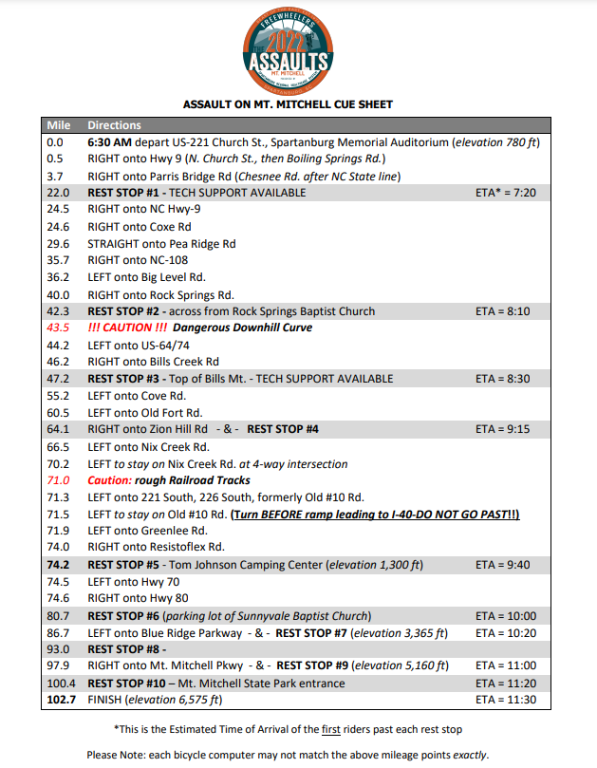
Cue Sheet

Slide 15
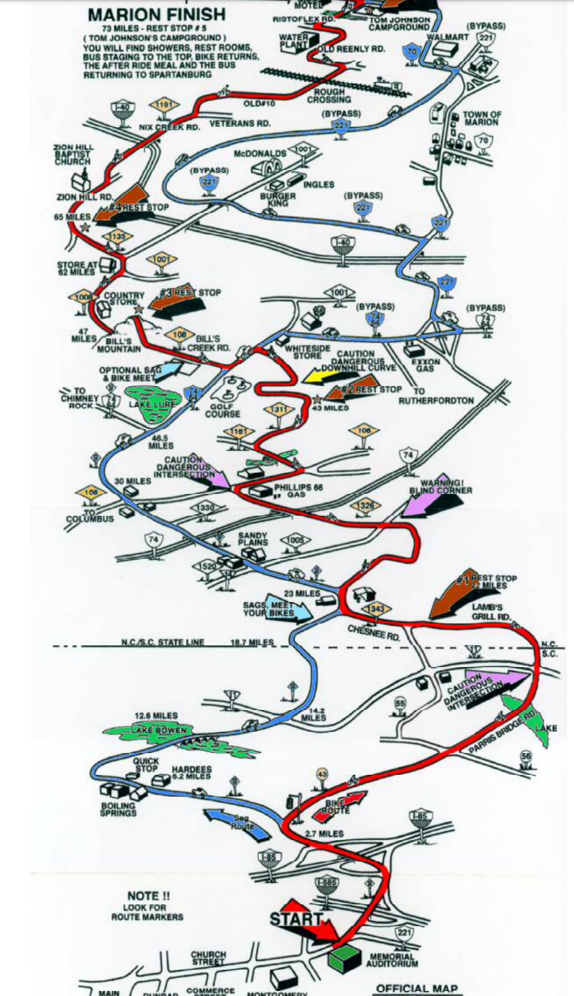
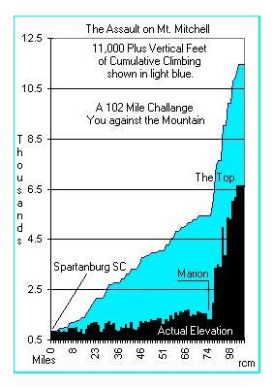
M
A
R
I
O
N

Slide 16
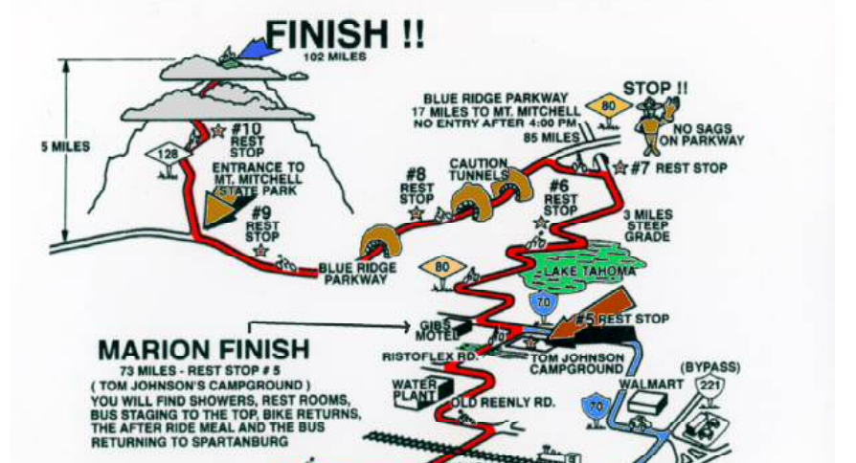
M
T
M
I
t
c
h
e
l
l

Slide 17
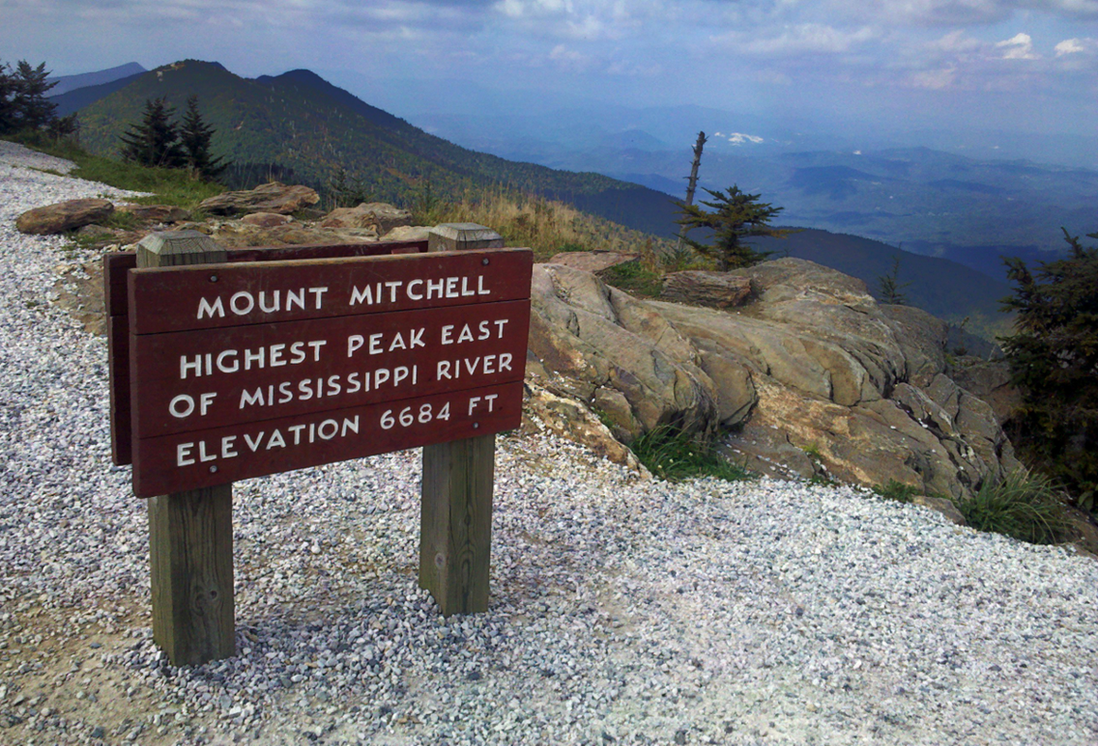
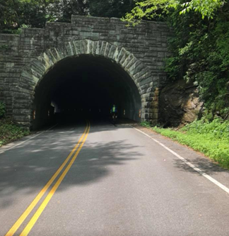
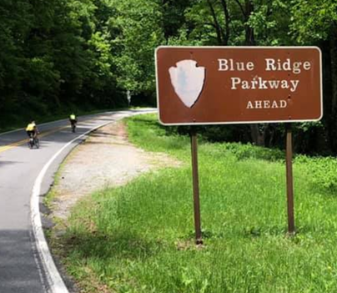
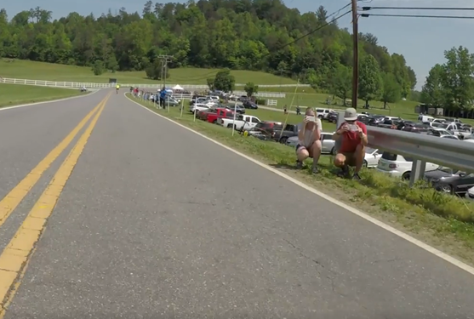
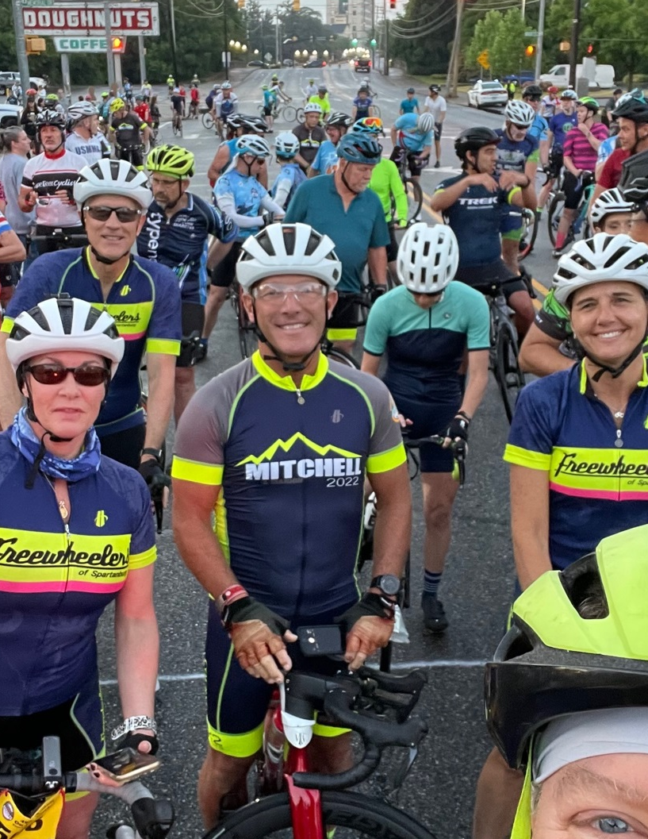
The Climb in pictures

Slide 18
The Ride on Video Marion Here is a video from Luc Morand on our 2018 group ride to Marion https://www.facebook.com/luc.morand.75/videos/10156439286377490/ Mitchell Here is a short video from a dear friend of ours Mike Stokes from 2015 ride. https://vimeo.com/128402584?ref=em-share

Slide 19
HAVE FUN

